Slide 1
Classify Neighborhoods for Modeling and Planning Applications
MoMo Minneapolis, MN 2025
Liming Wang, Ph.D., Portland State University

Slide 2
Motivations
Impact of Built Environment Factors on Travel
Many different measures on various scales: e.g. 3D/5D/7D …
Non-linear
Synergistic
Construct scenarios
Existing Methods
Clustering, :
Pros: Utilize multivariate data
Cons: Hard to interpret
PCA:
Reduce dimensions of multivariate data
Harder to interpret
Heuristics, such as place types
Pros: easier to interpret
Cons: not data driven

Slide 3
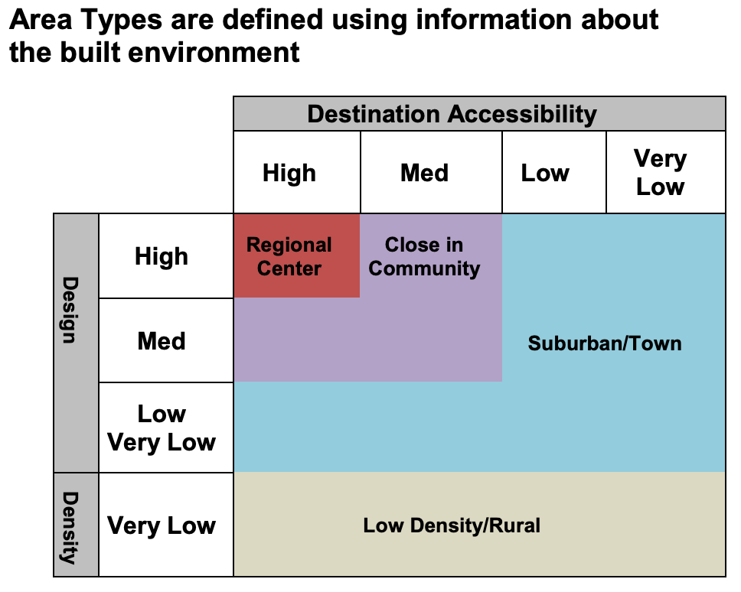
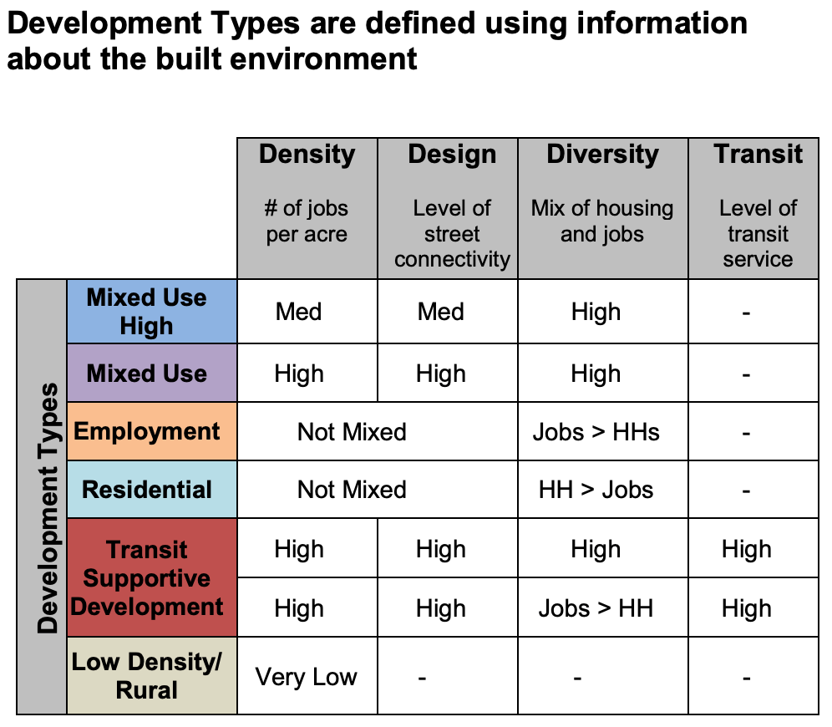
Place Types
Area Type describes the interdependencies of each neighborhood compared to the rest of the region
Development Type describes the physical characteristics of each neighborhood
Source: Oregon DOT https://www.oregon.gov/lcd/cl/pages/place-types.aspx

Slide 4
A New Approach
Can we have the cake & eat it too?
Location Type:
Urban, Town, Rural
Area Type:
Regional Center, Urban Center, Inner Neighborhoods, Outer Neighborhood, Fringe
Diversity Type:
Residential, Employment, Mixed
Combine heuristics with a data driven approach using Census geography (CBG):
- Location Type: Random Forest model trained on Census Urban Area classification for consistent criteria over time
- Area Type: Shallow decision tree trained on NHTS + SLD for
- Diversity Type: Shallow decision tree trained on NHTS + SLD

Slide 5
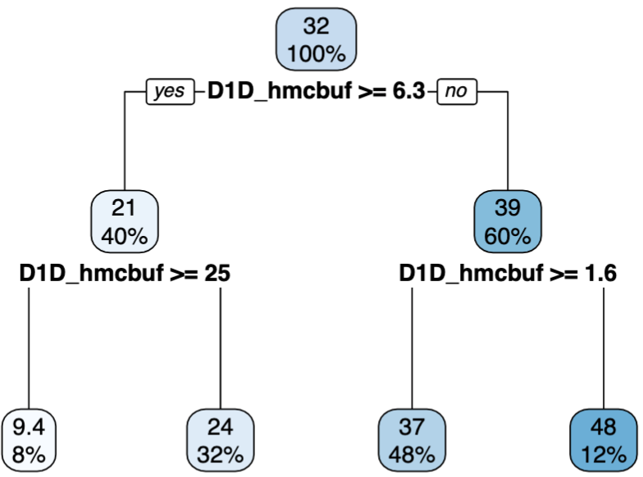
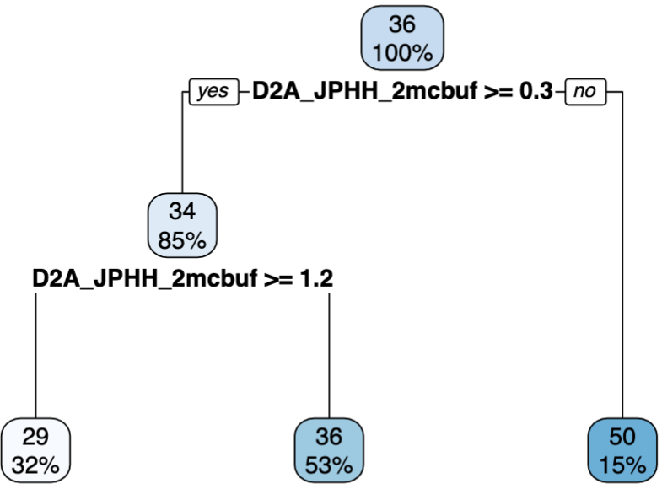
Area Type & Diversity Type Decision Trees
Area Type
Diversity Type
Center
Inner
Outer
Fringe
employment
mix
residential

Slide 6
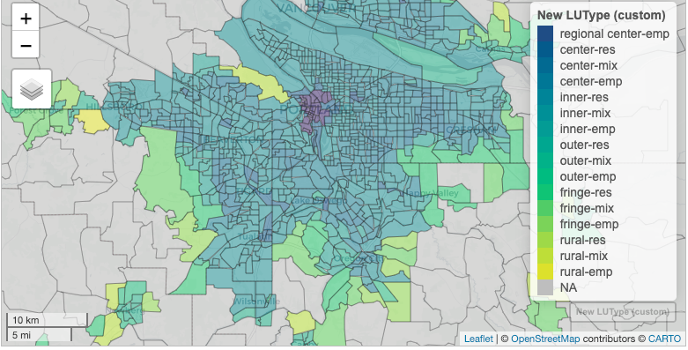
Classification Results - Portland, OR

Slide 7
Modeling & Applications
Land Use Types, used in the new VELandUse module for VisionEval (https://visioneval.org)
A good balance between prediction accuracy and level of details
Support three use cases with different specificity:
Use Case 1: user specifies CBG level population and employment
Use Case 2: user specifies CBG land use types
Use Case 3: Model predicts both CBG land use types, population and employment

Slide 8
Acknowledgements
Oregon DOT for financial support via SPR-868
Technical Advisory Committee
Brian Gregor
Questions:
Email: lmwang@pdx.edu
Github: https://github.com/VisionEval/VisionEval-Dev

